Slide 1
Motion Corrected CS MRI
Haris Jeelani

Slide 2
Introduction
Magnetic Resonance Imaging scans are a non-invasive and painless procedures.
Unlike X-rays and CT scan MRI does not use ionizing radiation (which is potentially harmful to the patient).
Uses powerful magnetic fields to encode the frequency and phase of the water molecules in body.
Popular for Brain Imaging. We work on Cardiac MRI: improve resolution and remove motion.

Slide 3
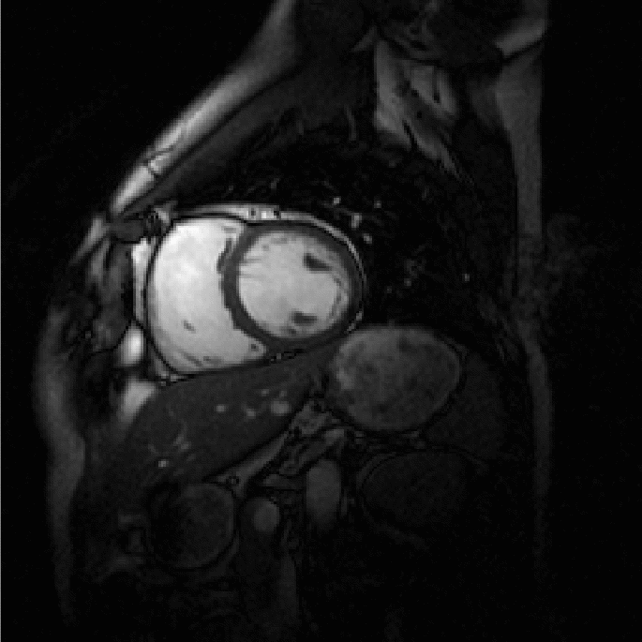
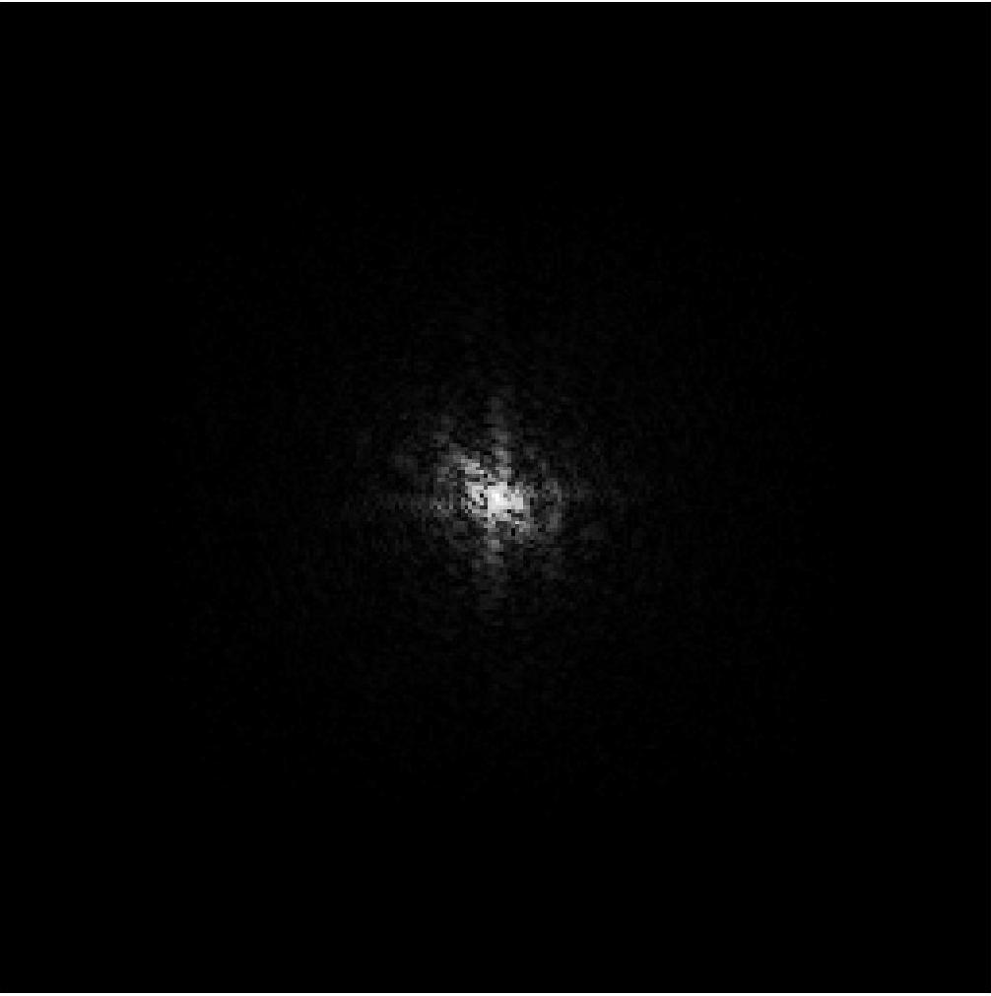
More than 10 years ago …
Frequency Encoding
Uniform Sampling.
Recon is very fast.
Major Drawback: Acquisition is very slow.
(After repeating for all frames)
Phase Encoding
ifft2
Abs value
Ref: H. Jung (k-tFOCUSS data)

Slide 4
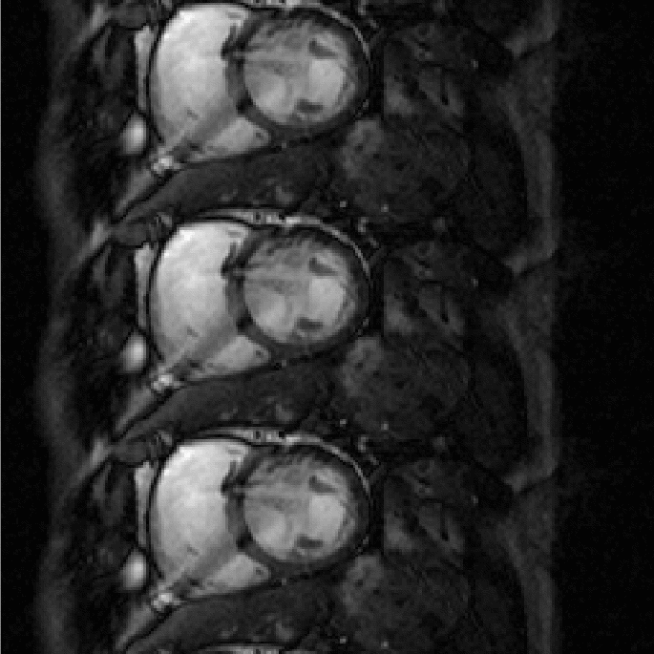
Undersampling
Try to acquire less data by skipping lines to speed up the acquisition.
Aliasing:

Slide 5
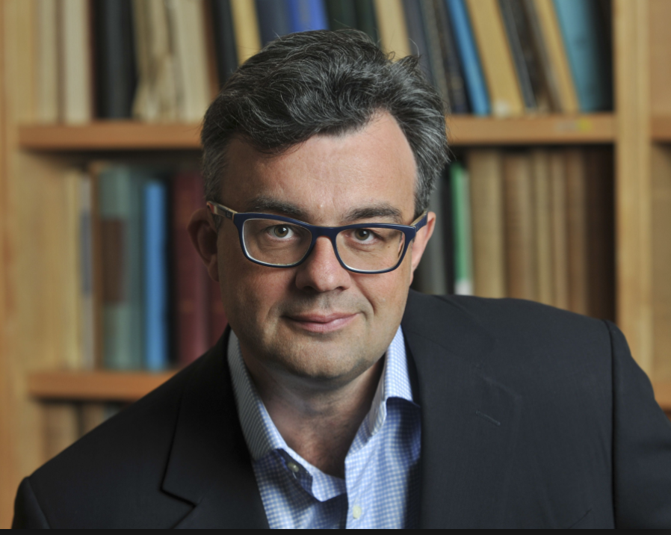
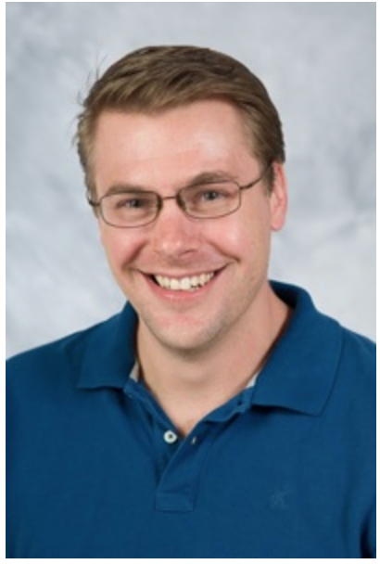
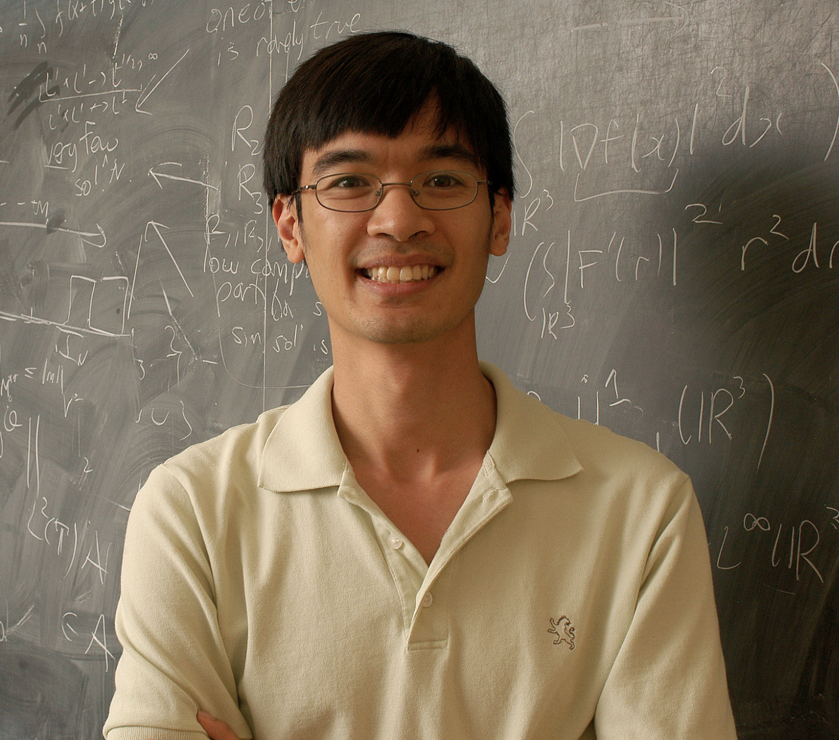
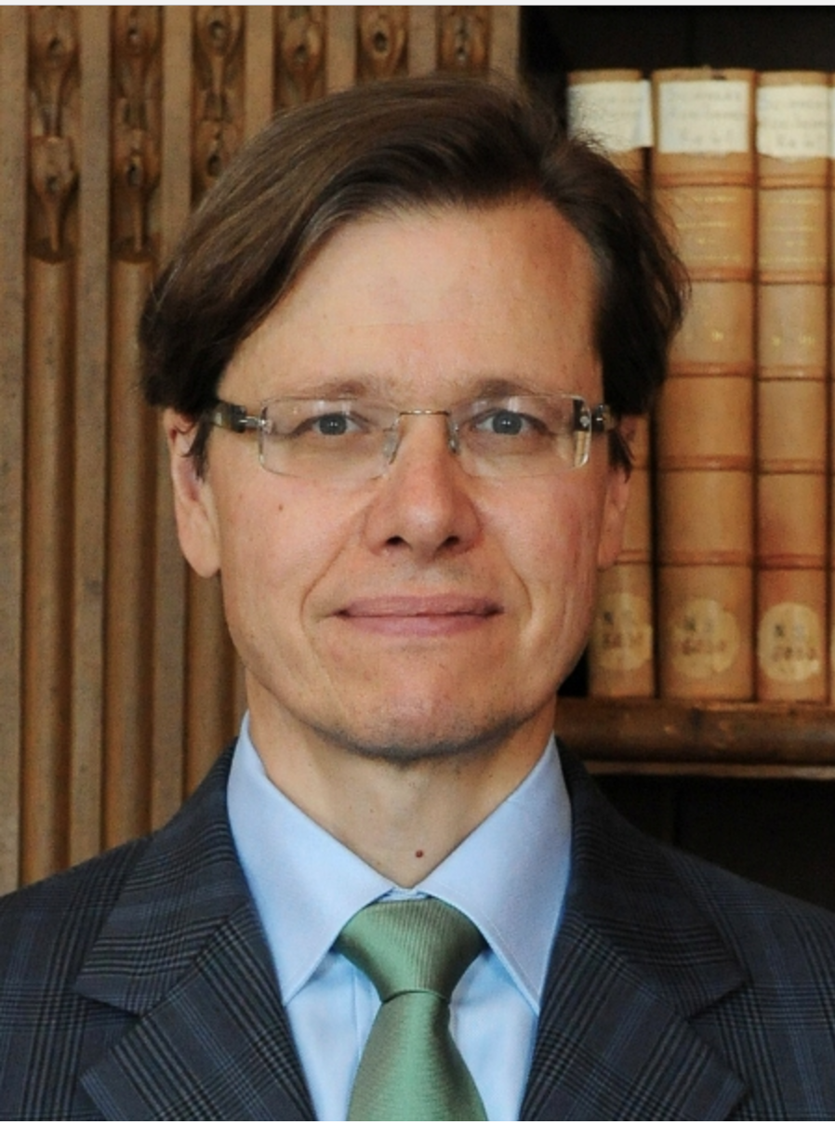
Compressed Sensing
No need to use Nyquist sampling if the signal is sparse in the representation basis that is incoherent with the sensing basis.[Picture in next slide].
Random Sampling (non uniform works too) helps satisfy the Restricted Isometry Property [will not be discussed] of CS.
MRI signal can be sparse in different domains, Eg: Total Variation.
So, fix Total Variation as your representation basis and sense randomly in k-Space (Fourier) to make compressed sensing work for MRI.
(clockwise from top right) Emmanuel Candès, Justin Romberg, David Donoho and Terence Rao.

Slide 6
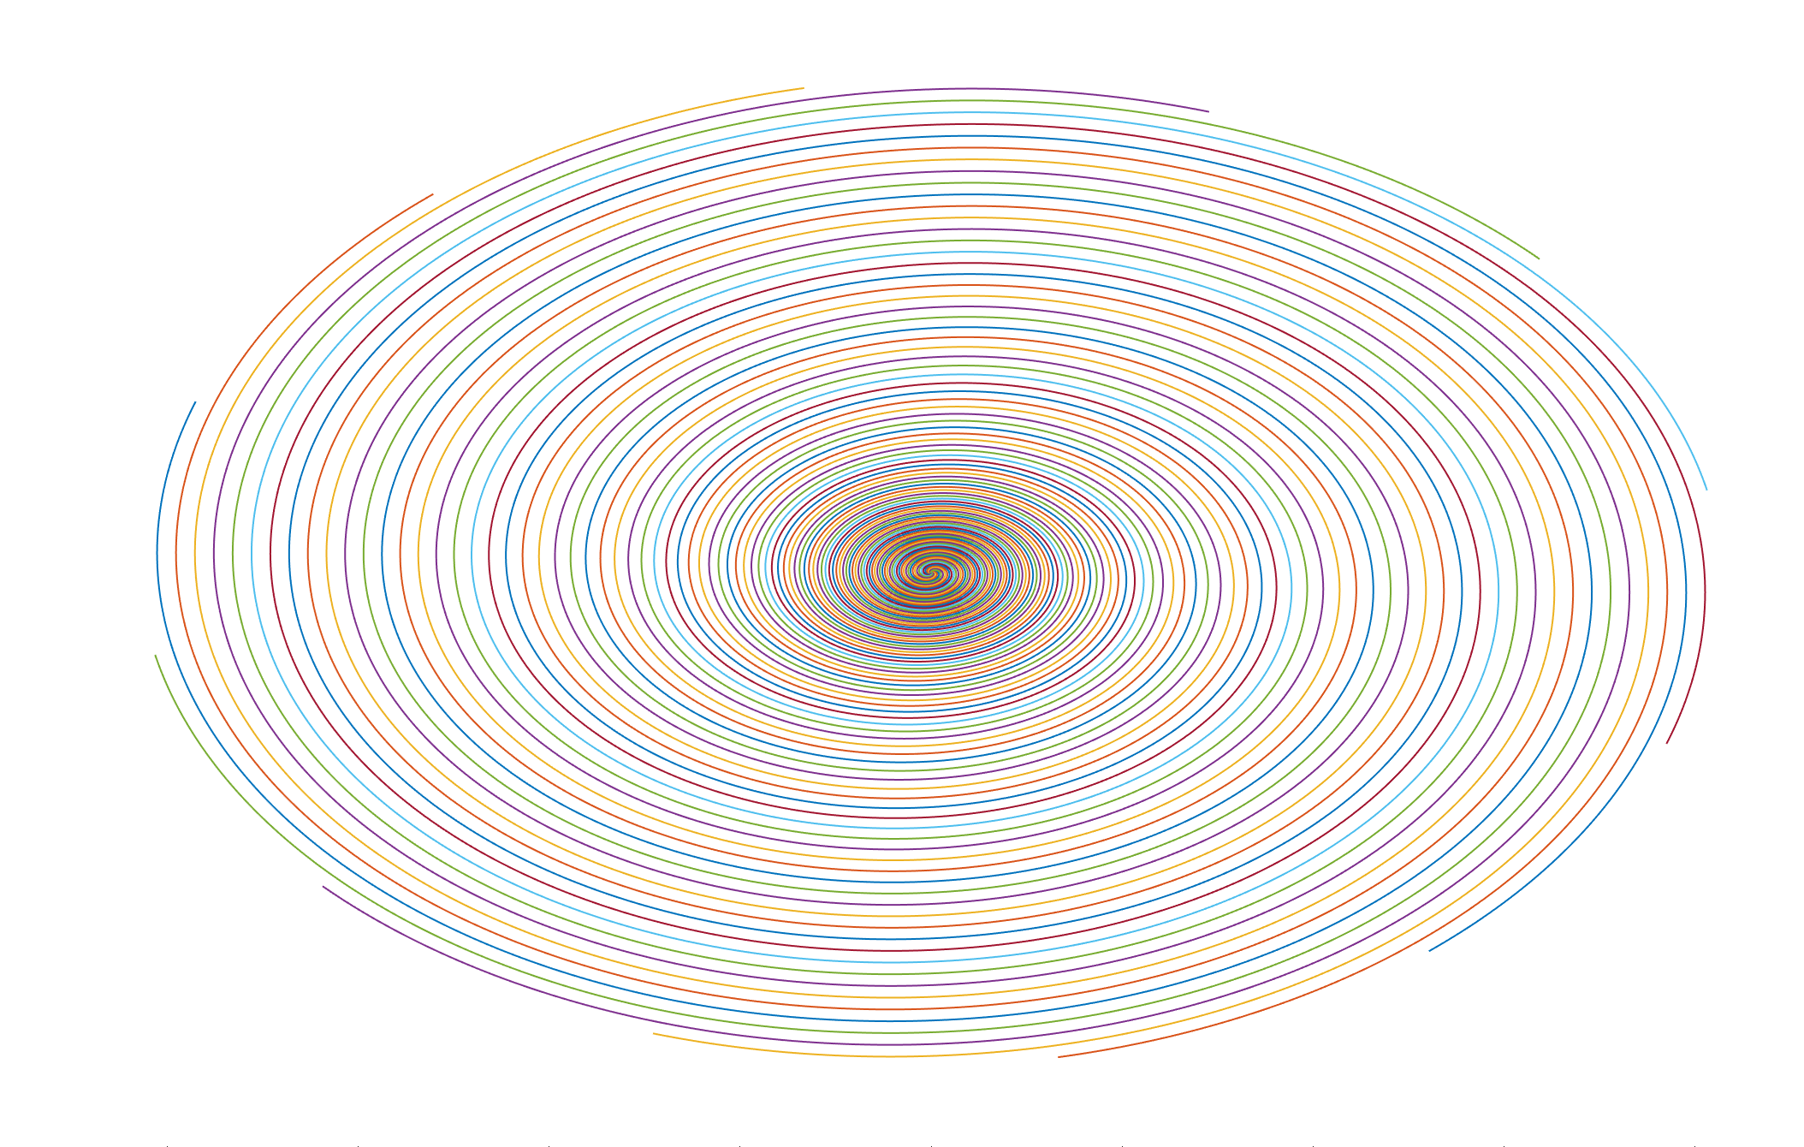
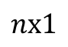
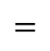
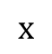
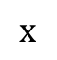
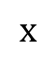
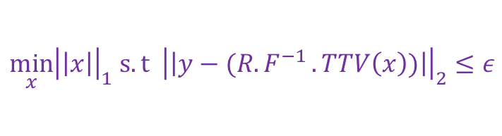
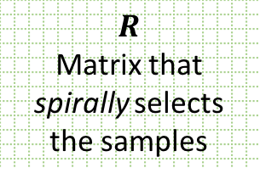
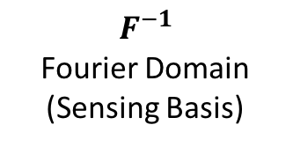
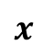
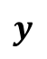
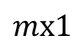
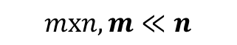
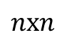
Matrix Representation of CS-MRI
$$y$$
$$x$$
∫
$$R$$
Matrix that spirally selects the samples
$$=$$
$$F^{−1}$$
Fourier Domain
(Sensing Basis)
Temporal TV Total Variation Domain
(Representation Basis)
$$x$$
$$x$$
$$x$$
$$mx1$$
$$mxn, m≪n$$
Measurements from the scanner
$$nx1$$
$$nxn$$
$$nxn$$
Signal that we have to recover. (Take Inverse TV to see the actual image).
$$\min_{x}{{\left|\left|x\right|\right|}_{1} s.t {\left|\left|y−(R{.F}^{−1}.TTV\left(x\right))\right|\right|}_{2}≤ε}$$
Thanks to Dr. Yang and Dr. Salerno for the data.

Slide 7
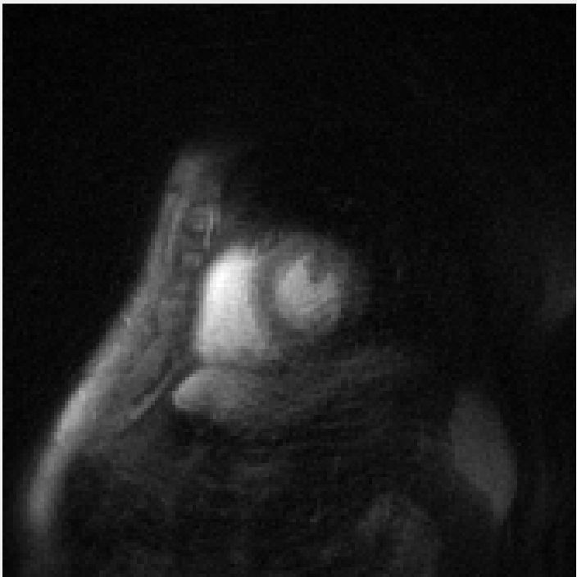
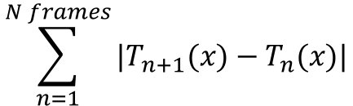
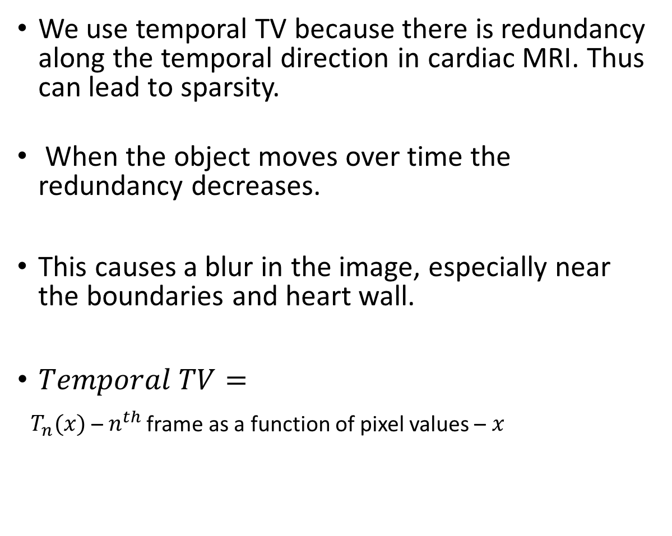
Motion in MRI
We use temporal TV because there is redundancy along the temporal direction in cardiac MRI. Thus can lead to sparsity.
When the object moves over time the redundancy decreases.
This causes a blur in the image, especially near the boundaries and heart wall.
$Temporal TV=$
$T_{n}(x)$ – $n^{th}$ frame as a function of pixel values – $x$
$$\sum_{n=1}^{N frames}{{|T}_{n+1}(x)−T_{n}(x)|}$$

Slide 8
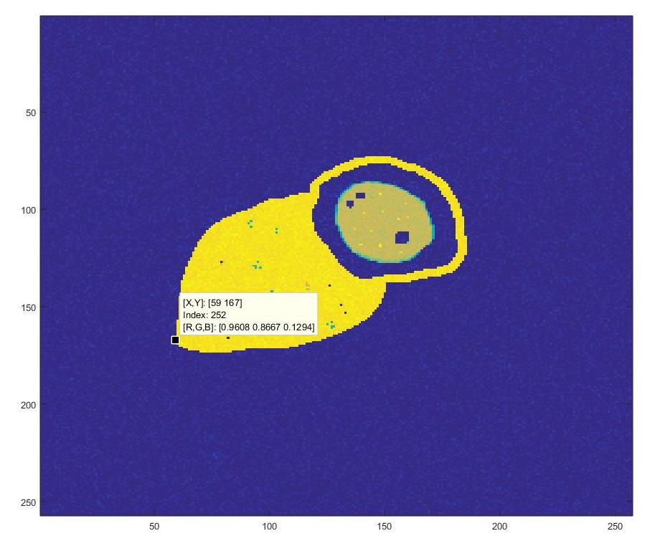
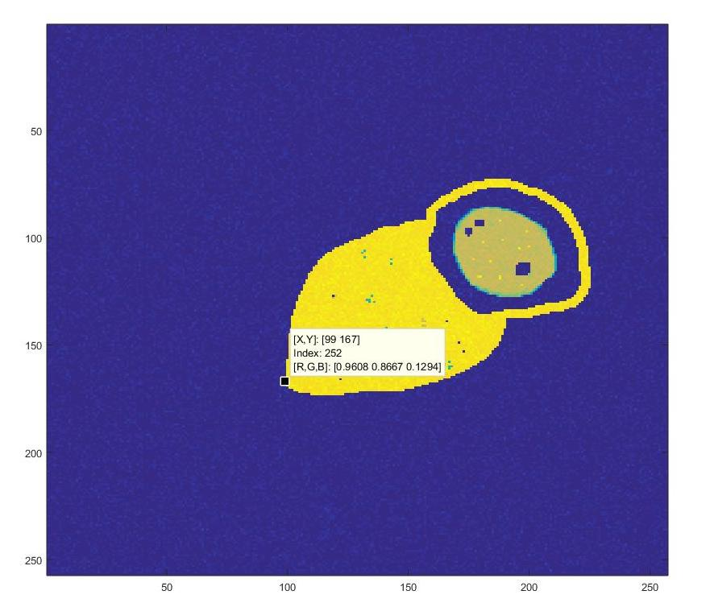
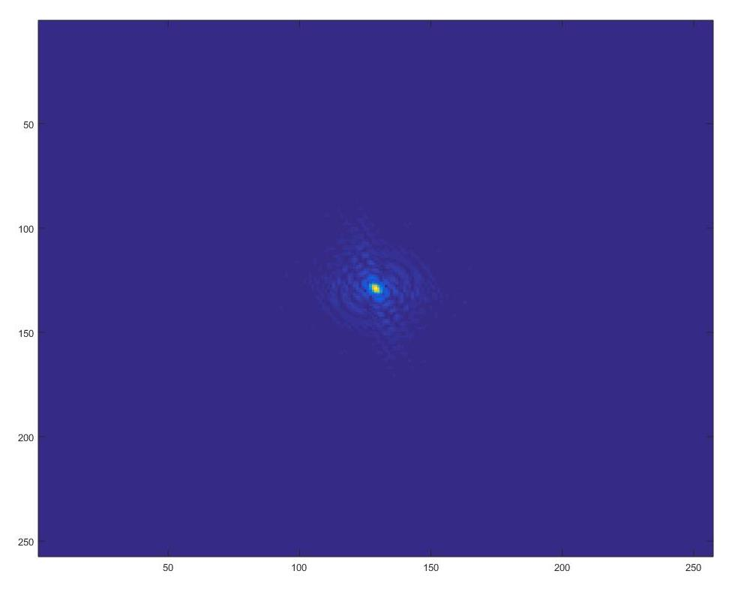
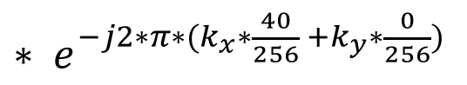
Phase Shift Property (very cool)
FT Domain
[X Y] = [59 167]
Index = 252
[X Y] = [99 167]
Index = 252
${∗ e}^{−j2∗π∗(k_{x}∗\frac{40}{256} +k_{y}∗\frac{0}{256})}$

Slide 9
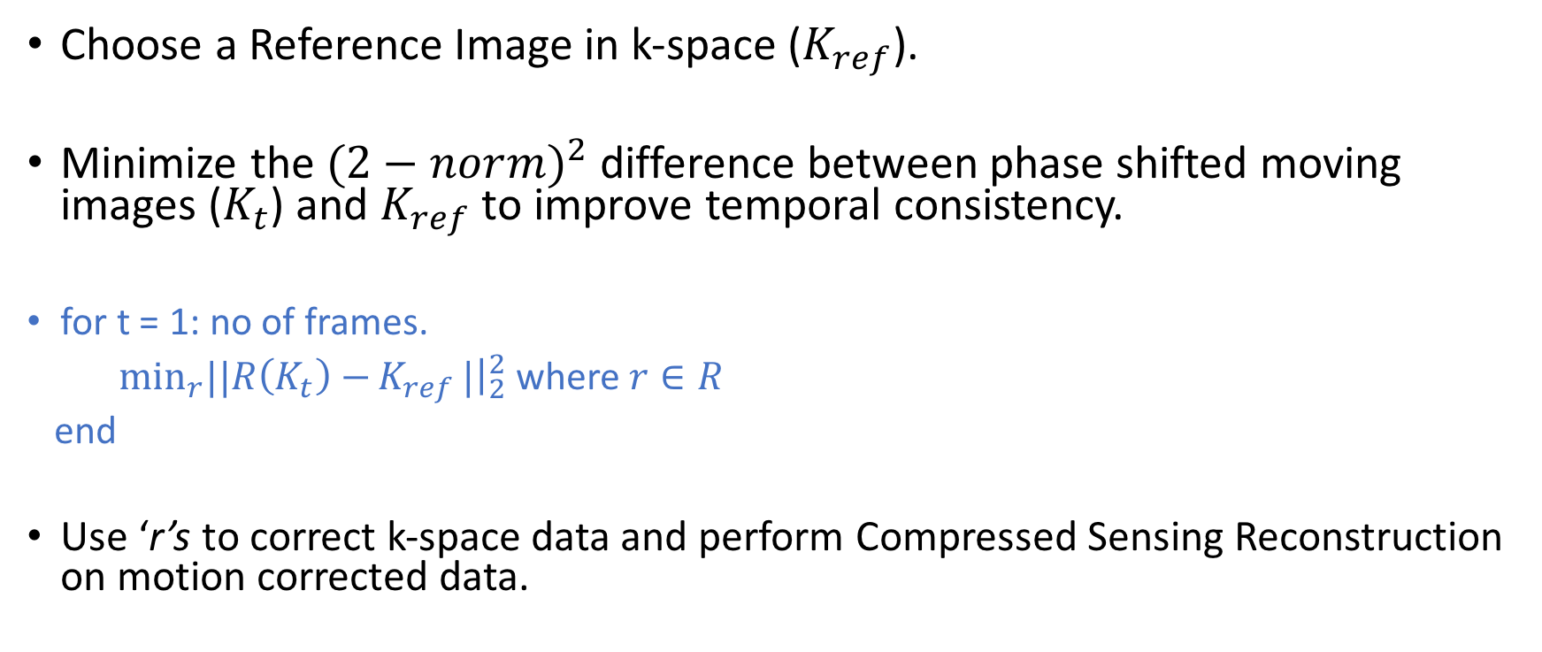
Motion Correction
Choose a Reference Image in k-space ($K_{ref}$).
Minimize the $(2−nor{m)}^{2}$ difference between phase shifted moving images ($K_{t}$) and $K_{ref}$ to improve temporal consistency.
for t = 1: no of frames.
$\min_{r}||R\left(K_{t}\right)−{K_{ref}}|{\left.​\right|}_{2}^{2}$ where $r∈R$
end
Use ‘r’s to correct k-space data and perform Compressed Sensing Reconstruction on motion corrected data.

Slide 10
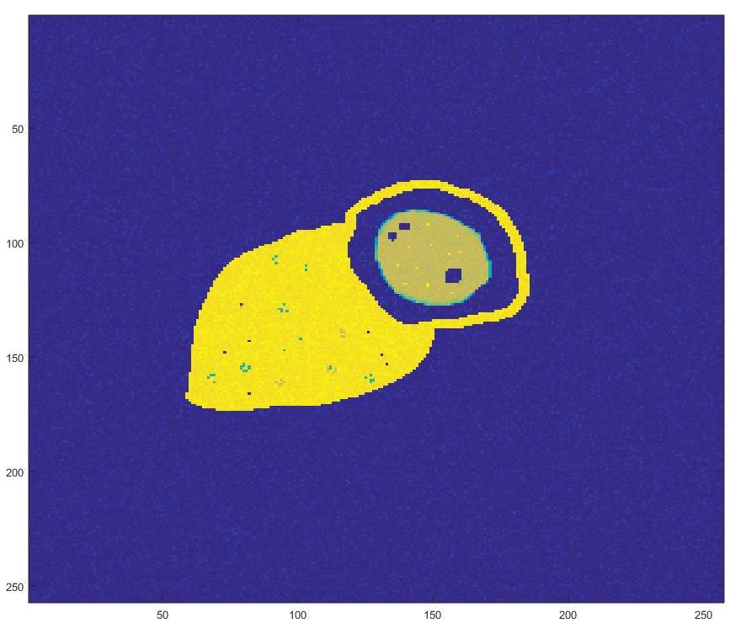
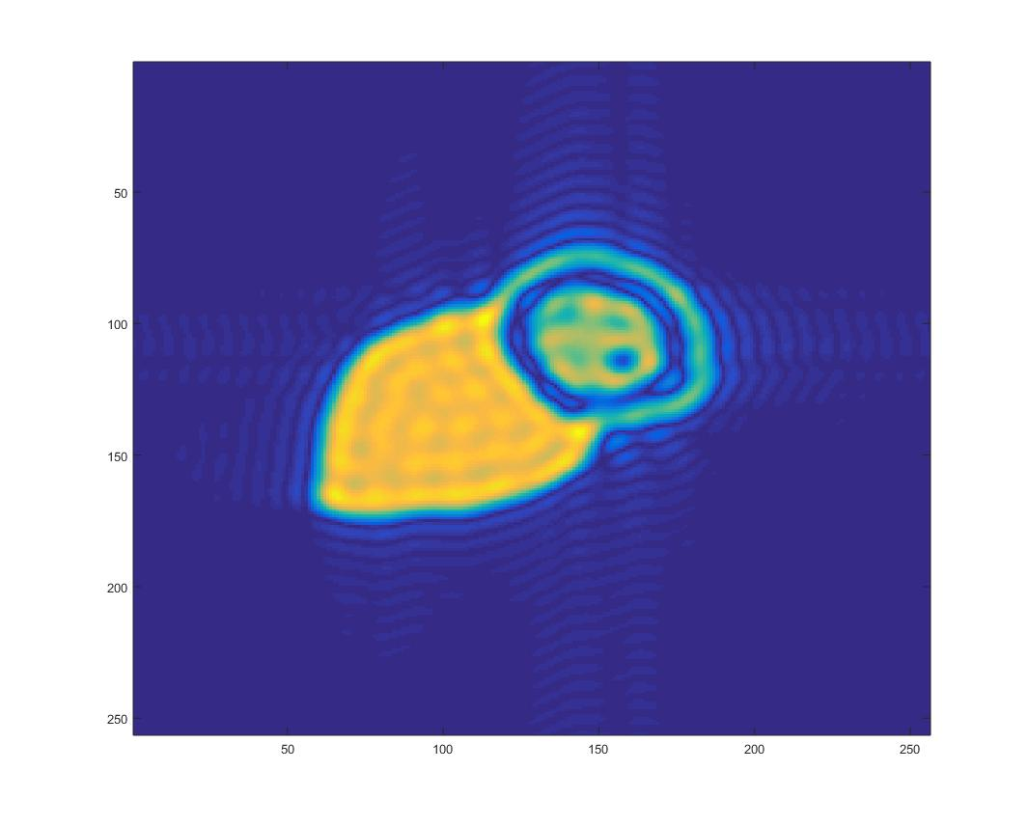
Improve Accuracy using center of k-Space.
Get rid of high frequency noise that is found on the periphery of k-Space by cropping the center of k-Space.
We can still preserve most of the information even after doing that.
Use center of k-Space to estimate the phase shifts but apply these phase shifts to whole k-Space after estimation.
Results >>

Slide 11
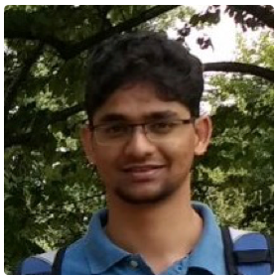
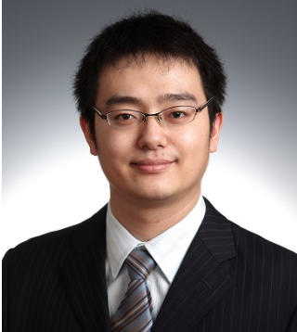
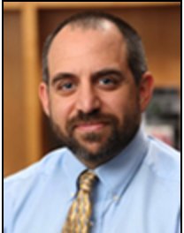
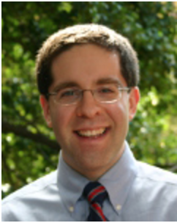
H
L
R
F
H
With Motion (1 frame)
F
Haris Jeelani (EE)
Dr. Yang Yang (BME)
Time
L
R
After k-Space motion estimation & compensation
After k-Space motion estimation & compensation
Dr. Michael Salerno (BME)
Dr. D. S. Weller (ECE)
With Motion

Slide 12
THANK YOU

